Slide 1
Logistic Regression

Slide 2
Logistic Regression
Also Called Logit Model. It is based upon linear equation of independent variables but later converted into non-linear
Y = a+bx
Output is first provided in probability then assigned into category
Two Main Objectives
1. Establish if there is a statistically significant relationship between two variables. (Classification and Prescription)
2. Mostly used for Binary classification (Target variable is binary/categorical). (Classification)
e.g. Whether the person will default on loan (Yes/No)
e.g. Whether team india will win (Yes/No)
e.g. Whether this email is spam (Yes/No)
e.g. Whether person will click on my campaign (Yes/No)

Slide 3
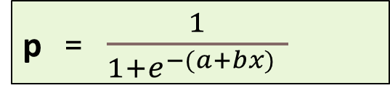
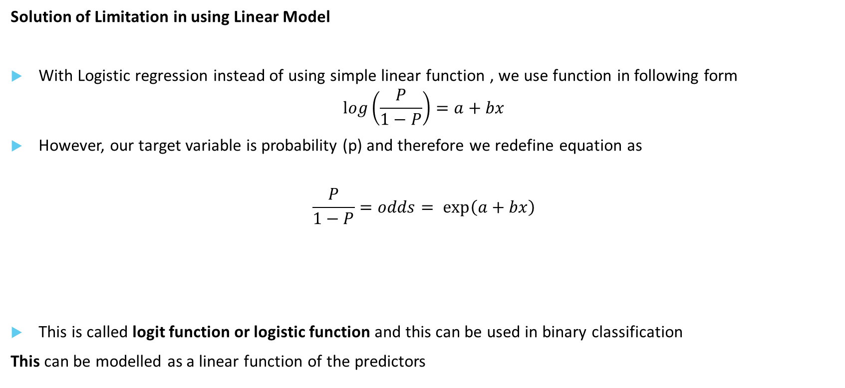
Logistic Regression
Solution of Limitation in using Linear Model
With Logistic regression instead of using simple linear function , we use function in following form
$$\log\left(\frac{P}{1−P}\right)=a+bx$$
However, our target variable is probability (p) and therefore we redefine equation as
$$\frac{P}{1−P}=odds= \exp\left(a+bx\right)$$
This is called logit function or logistic function and this can be used in binary classification
This can be modelled as a linear function of the predictors
p = $\frac{1}{1+ⅇ^{−(a+bx) }}$

Slide 4
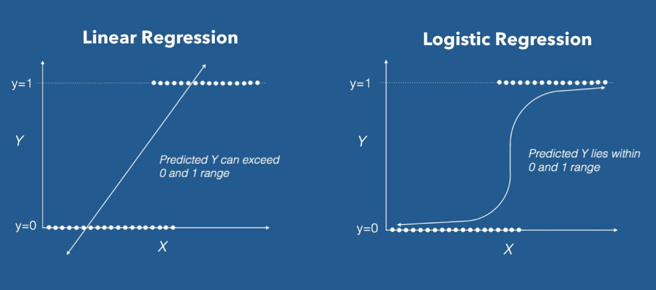
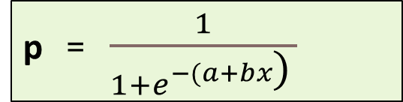
Logistic Regression
p = $\frac{1}{1+ⅇ^{−(a+bx\text{)} }}$
This type of function is called sigmoid function.
Sigmoid functions most often show a return value (y axis) in the range 0 to 1
This curve
Is sometimes referred
As S-curve

Slide 5

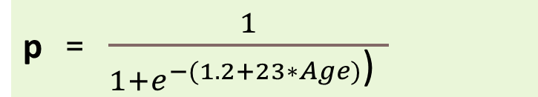
Logistic Regression
Threshold level cut off
Default Model produces an estimated probability of being a “1”
Hence we can define a threshold level to assign a label to outcome.
e.g. For a bank loan default problem
Target variable is default . 1 = default , 0 = non-default
p = $\frac{1}{1+ⅇ^{−(a+bx) }}$
P=0.7
p = $\frac{1}{1+ⅇ^{−(1.2+23∗Age)\text{)} }}$
P (y = ‘Default’/Age = 46) = 0.7
if logit function gives p= 0.7, we can say that if I keep threshold at 0.5 for risk management,
This person will be put under loan default category.

Slide 6
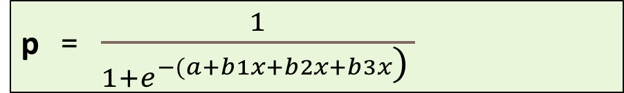
Multiple Logistic Regression
multiple logistic regression analysis applies when there is a single target variable and more than one independent variable
p = $\frac{1}{1+ⅇ^{−(a+b1x+b2x+b3x\text{)} }}$
e.g. what is the probability that a customer will buy my product given certain attribute
p = $\frac{1}{1+ⅇ^{−(\text{100 }\text{−}\text{ 10∗(}\text{Distance} \text{k}\text{.}\text{m}\text{. }\text{of} \text{warehouse}\text{) – 132.3∗(}\text{Product} \text{Price} \text{in} \text{Rs}\text{)} \text{)} }}$

Slide 7
Multiple Logistic Regression
New Considerations : Adding more independent variables doesn’t mean that the logistic regression will be better; in fact it can make things worse.
Overfitting
When fitting models, it is possible to increase the likelihood by adding parameters, but doing so may result in overfitting. Model will be too complex that it will fail to generalize well on test data (unseen data).
Multicollinearity
The addition of more independent variables creates more relationship among them.
Not only are the independent variables correlated to the dependent variable,
they are also potentially correlated to each other.

Slide 8
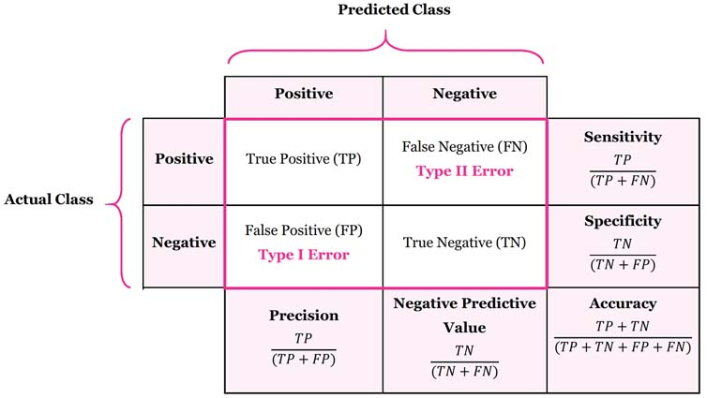
Metrics
Confusion Matrix
Accuracy Total correct predictions out of total observation
Sensitivity/True Positive rate/Recall measures the proportion of positives that are correctly identified. the proportion of those who are spam and correctly identified as “Spam”.
Specificity/True Negative rate measures the proportion of negative that are correctly identified. the proportion of those emails who are non spam and correctly identified as “Non -Spam.”

Slide 9
Metrics
AIC: Given a collection of models for the data, AIC estimates the quality of each model, relative to each of the other models. Thus, AIC provides a means for model selection. It signifies the amount of information loss in model.
BIC: BIC is also a criterion for model selection among a finite set of models; the model with the lowest BIC is preferred
Both BIC and AIC attempt to introduce a penalty term for the number of parameters in the model; the penalty term is larger in BIC than in AIC. Thus they help to avoid overfitting.
ROC – Receiver Operating Characteristics : Shows the plot between True positive rate and False positive at different threshold value
AUC – Area Under the ROC Curve
AUC – Measures discrimination, i.e., ability to correctly classify those SPAM and NON-SPAM.
AUC is the percentage of randomly drawn such pairs for which the classification is done correctly.

Slide 10
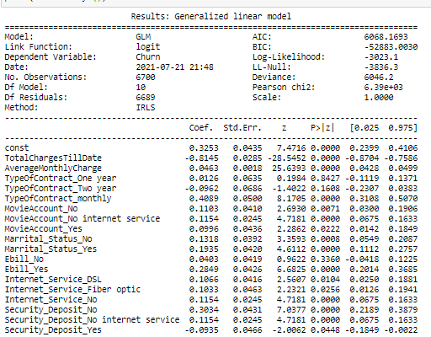
Logistic Regression
1 .Equation:
Log(odds) = 0.3252 - 0.8145*TotalchargesTillDate …. -0.0935*Security_Deposit_Yes
2. Compare two models using
AIC (Akaike information criterion)
BIC (Bayesian information criterion)
Lesser the better
3. Identify significant variables that impact log(odd) using p value
4. Variables with (-) coefficients tells us they have negative
Impact on churn of customers.

